Slide 1
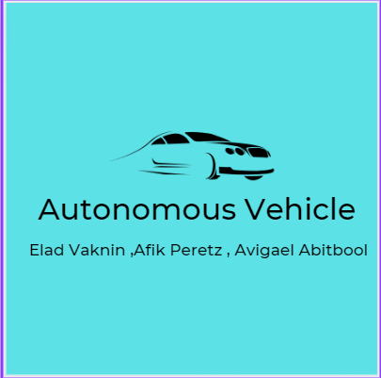








Autonomous Vehicle Elad Vaknin ,Afik Peretz, Avigael Abitbool Instructed by Professor Boaz Ben Moshe
31
Contribution/project goal: The project is designed to develop a solution for navigation in autonomous vehicles (in a simulator or a real car), with an emphasis on the reliability of the autonomous software.
2. Introduction : The world is progressing towards autonomous vehicles with autonomous control, one of the main systems required for the field is a reliable system that can scan its environment and give an accurate indication of when an accident danger occurs and prevent it by braking / acceleration.
For this to happen - the system needs to be sensitive and accurate and know how to scan the environment in real time and act accordingly - which is why we developed the tool we chose.
3. Methods/algorithms/Alternatives or Design Considerations : The main algorithm used in the system is the SLAM algorithm - which knows according to mathematical calculations to map spaces in three dimensions and within a few scans to reach very high accuracy.
For the rest of the methods and technology a broader detail is seen in the project itself.
4. Selected Approach : Using an intel real sense camera, we photographed selected spaces to produce suitable bag files for use by the designed tool.
The tool uses the SLAM algorithm to map the space and thus a three-dimensional space is obtained that the vehicle knows how to move according to the resulting scan.
5. Solution Description :
Visit Us

